Slide 1


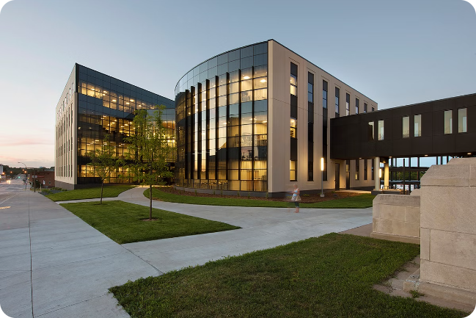


Introduction to Employee Performance Analysis
Employee performance analysis is a vital process for organizations to assess employee performance, identify areas for improvement, and ultimately, enhance organizational productivity. This analysis helps understand individual contributions, strengths, and weaknesses, leading to targeted development strategies and optimized workforce performance.
by Kavi Dharshini

Slide 2

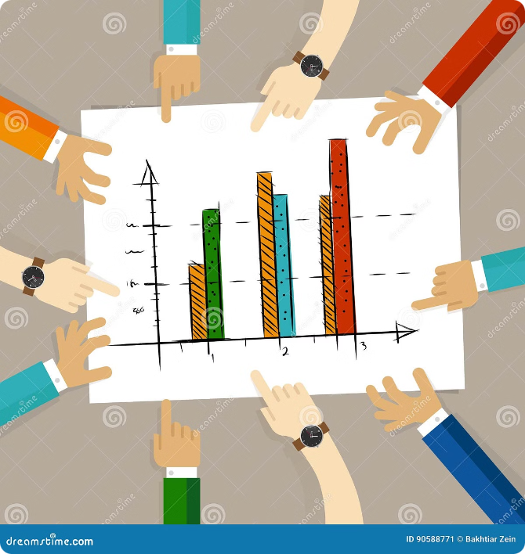
Importance of Performance Tracking
1
Employee Growth
2
Improved Productivity
Regular performance tracking provides employees with valuable feedback, empowering them to understand their strengths and weaknesses, and fostering their professional development. This ongoing feedback loop helps employees stay motivated, engaged, and focused on achieving their goals.
By identifying areas where employees excel or struggle, organizations can allocate resources and support effectively, enhancing overall productivity and efficiency. This targeted approach leads to better utilization of skills and expertise, ultimately contributing to a more productive workforce.
3
Data-Driven Decision-Making
4
Organizational Alignment
Performance tracking provides valuable data that can be used for informed decision-making regarding employee development, promotion, and compensation. This data-driven approach ensures that decisions are fair, transparent, and aligned with organizational goals and objectives.
Performance tracking helps ensure alignment between employee performance and organizational objectives. By assessing individual contributions and aligning them with broader goals, organizations can ensure that everyone is working towards a shared vision and contributing to the success of the organization.

Slide 3
Key Performance Indicators (KPIs)
Productivity
Quality
Engagement
Measures the efficiency and effectiveness of an employee's work. This can include metrics like sales figures, output volume, and completion rates.
Evaluates the accuracy, precision, and excellence of an employee's work. Examples include customer satisfaction scores, error rates, and defect rates.
Assesses an employee's level of involvement and enthusiasm in their work. Metrics include attendance, participation in meetings, and proactive contributions.
Sales targets achieved
Customer satisfaction ratings
Attendance and punctuality
Number of leads generated
Number of customer complaints
Team participation and collaboration
Average response time to customers
Accuracy of work output
Proactive problem-solving and innovation

Slide 4

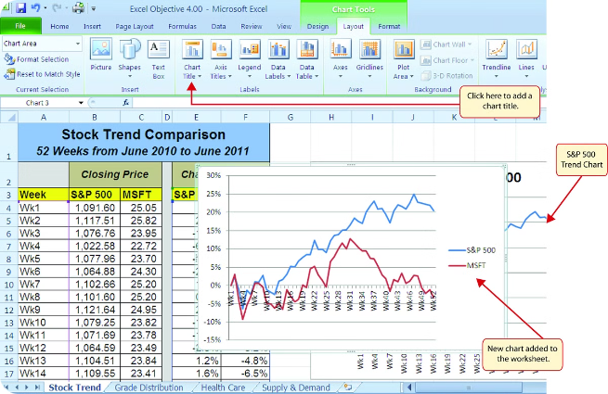
Data Collection and Organization in Excel
Column A
Employee Name
Column B
Department
Column C
KPI 1
Column D
KPI 2
Column E
KPI 3
Column F
Performance Rating
Column G
Comments
Excel is a powerful tool for collecting, organizing, and analyzing performance data. It allows for easy data entry, calculation of metrics, and generation of visual representations like charts and graphs, which help to gain insights into performance trends.

Slide 5

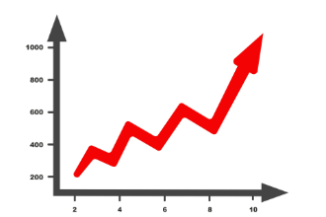
Analyzing Performance Trends
Predictive Insights
Data Visualization
Based on analyzed trends, organizations can project future performance and identify potential issues or opportunities. This proactive approach helps to make informed decisions regarding employee development and resource allocation.
Excel offers a variety of chart types, including line graphs, bar charts, and scatter plots, which can effectively visualize performance trends over time.
1
2
3
Trend Analysis
By analyzing performance data over time, organizations can identify patterns, positive or negative trends, and areas where improvement is needed.

Slide 6

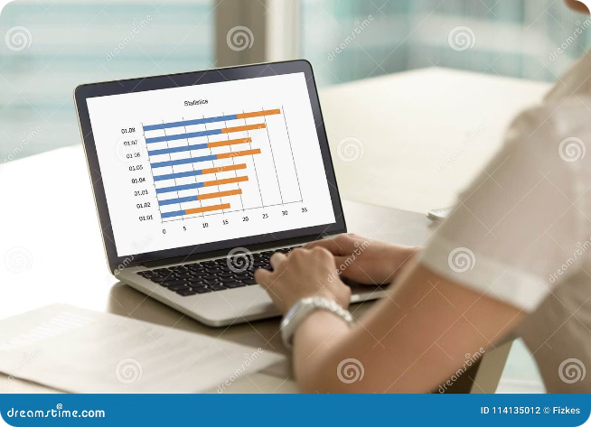
Identifying Strengths and Weaknesses
High Performing KPIs
Areas for Improvement
Identify KPIs where employees consistently exceed expectations. These areas represent their strengths and areas where they contribute significantly to the organization's success.
Identify KPIs where employees consistently fall short of expectations. These areas highlight potential weaknesses and areas where targeted development and support can be provided.
Feedback and Discussion
Regular discussions with employees about their performance data provide an opportunity to understand the reasons behind their strengths and weaknesses, fostering open communication and collaboration.

Slide 7





Developing Improvement Strategies
Tailored Development Plans
Based on identified weaknesses, develop individual development plans that address specific skills gaps or knowledge deficiencies.
Training and Skill Development
Provide relevant training programs or workshops to enhance employee skills in areas where improvement is needed.
Mentorship and Coaching
Assign mentors or coaches to provide ongoing support, guidance, and feedback to employees during their development journey.

Slide 8





Conclusion and Next Steps
Regular Performance Reviews
Implement a structured process for regular performance reviews, allowing for ongoing feedback, progress tracking, and adjustments to development plans.
Continuous Improvement
Employee performance analysis is an ongoing process, requiring continuous monitoring, evaluation, and adaptation of strategies to foster a culture of growth and improvement.
Employee Involvement
Encourage employee participation in the performance analysis process, fostering a sense of ownership and promoting a culture of open communication and collaboration.

